Slide 1
GROUP 6
Members
Parsley Njoroge – Sct211-0007/2023
Patrick Leon – Sct211-0003/2023

Slide 2
Task
Q1
Create a banner with the text 'JKUAT ROCKS'
Brown background
JKUAT in green, ROCKS in red
Text must be centered
Implemented using OpenGL and Python
Tools
OpenGL (GLUT) - real-time graphics rendering
C++ - implementation language
Python – implementation language
Pillow (PIL) - image processing library

Slide 3
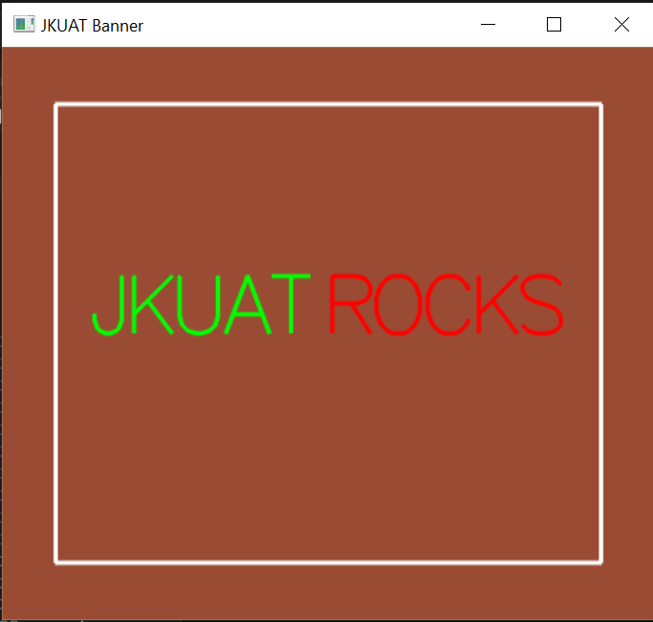
OpenGL Approach
Used GLUT stroke fonts to draw text
Calculated width using glutStrokeWidth()
Centered text using total width
Applied colors (green and red)
Added border and smooth rendering
Enabled scaling using keyboard (+ / -)

Slide 4

Python Approach
Used Pillow (PIL) to create image
Loaded TrueType font using ImageFont.truetype()
Measured text using textlength() and textbbox()
Centered text automatically
Applied colors and saved as image

Slide 5
Comparison
Feature | OpenGL | Python
Rendering Type | Real-time graphics | Image processing
Text Alignment | Manual calculation | Built-in measurement
Interactivity | Yes (keyboard scaling) | No
Font Support | Limited (GLUT) | TrueType support
Ease of Use | More complex | Easier

Slide 6
Polygon Convex Decomposition
Splitting Concave Polygons Using the Rotational Method

Slide 7
Finding the "Dents"
Instant Detection: A negative cross product result instantly confirms an interior angle is greater than 180 degrees, successfully identifying a concave vertex (a "dent").
Counter-Clockwise Traversal: The algorithm maps the perimeter of the shape, evaluating sets of three consecutive vertices at a time.
The Cross Product Shortcut: Instead of relying on slow, costly trigonometric rotations, the algorithm utilizes the 2D Cross Product.

Slide 8
Slicing the Geometry
Ray-Line Intersection: Once a dent is found, the algorithm shoots an infinite mathematical ray from that point across the interior of the shape.
Collision Detection: It iterates through the polygon's remaining edges to find the exact floating-point coordinate where the ray collides with an opposite boundary.
Bisection: The original array of vertices is severed at the collision point, cleanly dividing the geometry into two brand-new, independent polygons.

